Slide 1




Software Architecture
Introduction to Object Oriented Design Patterns in .NET

Slide 2
Chris Berthold : Your fearless live code presenter
Nearly 20 years of development experience developing software and DevOps/network administration
10 years of business development in a manufacturing setting
6 years of development as software consultant
4 years with the awesome Product Development Team for Flightdocs
Private pilot
Enjoys engaging others in software architecture, simplifying software design and practical performance in applications
http://github.com/cberthold/presentations
The twitters: @chrisberthold

Slide 4
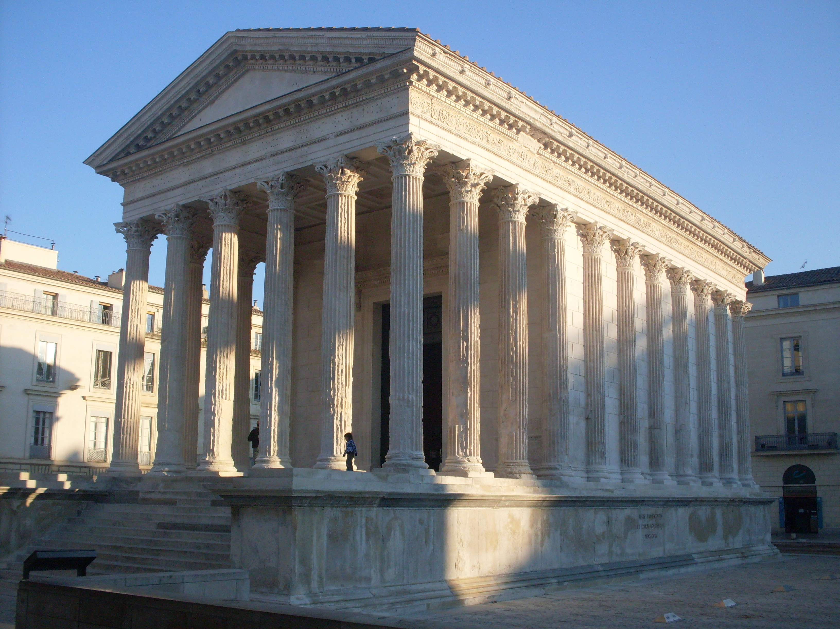
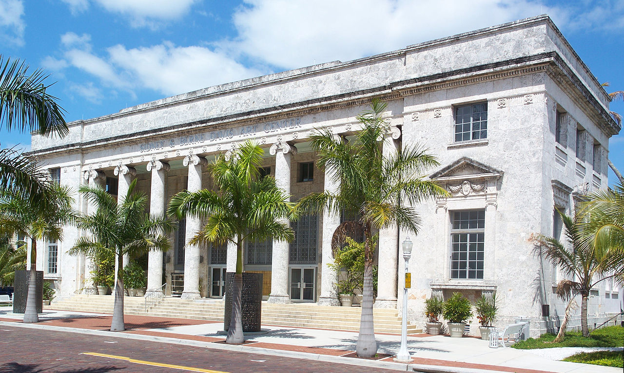



Slide 5
Christopher Alexander
widely influential architect and design theorist
best known for his 1977 book A Pattern Language
defined a pattern as a “solution to a problem in a context”
patterns where initially applied for architecture of building towns

Slide 6
Why Design Patterns?
Designing reusable object-oriented software is hard
Provides an optimized, reusable solution to the programming problems that we encounter every day
Helps communicate an architecture with other developers
A ubiquitous language
Is a template or recipe for solving a problem in a context

Slide 7
How Many are there? Lots!
Gang of Four (GoF) – Design Patterns: Elements of Reusable Object-Oriented Software (1995)
Erich Gamma
Richard Helm
Ralph Johnson
John Vlissides
Classification (23)
Creational – object creation (5)
Structural – relationships between entities (7)
Behavioral – communication between objects (11)
Higher-level Patterns
Enterprise Application Architecture (MVC, Front Controller) +
Enterprise Integration Patterns (Command Dispatcher, Messaging Patterns) ++
SOA Patterns (ESB, Atomic Service Transaction) +++
Cloud Integration Patterns (Circuit Breaker, CQRS) ++++

Slide 8
Describing Patterns (GoF)
Name and Classification -- Must have a meaningful name which conveys the essence of the pattern succinctly. Classification categorizes it into either creational, structural, or behavioral design patterns.
Intent -- A statement of the problem which answers the following questions: What does the design pattern do? What is its rationale and intent? What particular design issue problem does it address?
Also Known As -- Other well-known names for the pattern, if any.
Motivation -- A scenario that illustrates a design problem and how the class and object structures in the pattern solve the problem. The scenario will help you understand the more abstract description of the pattern that follows.
Applicability -- What are the situations in which the design pattern can be applied? What are example of poor design that the pattern can address? How can you recognize these situations?
Structure -- A graphical representation of the classes in the pattern using a notation based on the Object Modeling Technique (OMT). (UML, based on OMT, is now the standard notation used.)
Participants -- The classes and/or objects participating in the design pattern and their responsibilities.
Collaborations -- How the participants collaborate to carry out their responsibilities.
Consequences -- How does the pattern support its objectives? What are the trade-offs and results of using the pattern? What aspect of system structure does it let you vary independently?
Implementation -- What pitfalls, hints, or techniques should you be aware of when implementing the pattern? Are there language-specific issues?
Sample Code and Usage -- Code fragments that illustrate how you might implement the pattern in C++ or Smalltalk (or Java).
Known Uses -- Examples of the pattern found in real systems.
Related Patterns -- What design patterns are closely related to this one? What are the important differences? With which other patterns should this one be used?

Slide 9
Simplified
Pattern Name
Short name to describe the pattern in a word or two
Problem
When should we use the pattern?
Solution
Describes elements of the design
Not a concrete implementation but abstract description of problem and solution
Consequences
Results and trade-offs
Helps identify when other patterns or solutions should be considered

Slide 10
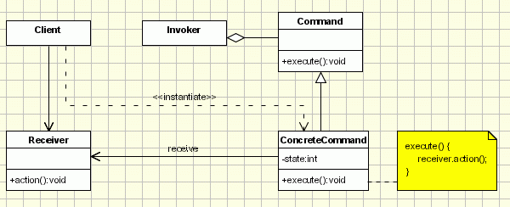
Command Pattern (Behavioral)
Problem: Coupling the invoker of a request to a particular request should be avoided. That is, hard-wired requests should be avoided.
Solution: Define separate (command) objects that encapsulate a request.
A class delegates a request to a command object instead of implementing a particular request directly.
Consequences:
Command decouples the object that invokes from the one that knows how to perform the operation
You can assemble commands into a composite command
Easy to add commands since there is no reason to change existing classes
Can be used to separate business use-cases

Slide 11
Null-Object Pattern
Problem: In most object-oriented languages, such as Java or C#, references may be null. These references need to be checked to ensure they are not null before invoking any methods, because methods typically cannot be invoked on null references.
Solution: Instead of using a null reference to convey absence of an object (for instance, a non-existent customer), one uses an object which implements the expected interface, but whose method body is empty.
Consequences:
Object is very predictable and has no side effects: it does nothing
can also be used to act as a stub for testing, if a certain feature such as a database is not available for testing
Can be used as a feature toggle replacement

Slide 12
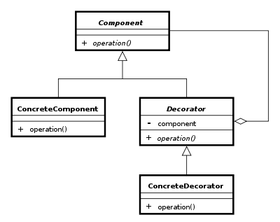
Decorator Pattern (Structural)
Problem: Responsibilities should be added to (and removed from) an object dynamically at run-time and/or you need a flexible alternative to sub-classing for extending functionality.
Solution: Define a decorator object that implements the interface of the extended (decorated) object (Component) transparently by forwarding all requests to it and perform additional functionality before/after forwarding a request.
Consequences:
Provides more flexible means of adding responsibilities
Functionality can be added at runtime
Decorator and enclosed objects are not identical
Can lead to many little objects if over-used

Slide 13
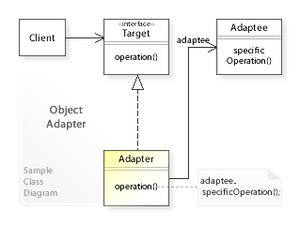
Adapter Pattern (Structural)
Problem: You have a class that does what you need behaviorally but does not implement the same interface the rest of your program requires.
How can a class be reused that does not have an interface that a client requires?
How can classes that have incompatible interfaces work together?
How can an alternative interface be provided for a class?
Solution: An adapter allows two incompatible interfaces to work together. This is the real-world definition for an adapter. Interfaces may be incompatible, but the inner functionality should suit the need. The Adapter design pattern allows otherwise incompatible classes to work together by converting the interface of one class into an interface expected by the clients.
Consequences:
Class adapter requires multiple inheritance (Protocols)
Object adapter contains the object being adapted

Slide 14
Things to know when applying design patterns
Don’t try to force a design pattern into a situation
You cannot build a program using all of the patterns
They do not prescribe an implementation and are somewhat interchangeable
Apply the patterns when you:
see a pattern developing that could benefit from applying the pattern (refactor towards patterns)
have known architectural needs that patterns can help with
Use judiciously, they can get you into a bind.
Favor the Behavioral and Structural patterns for your low-level concerns
Favor Dependency Injection over using Creational Patterns
Use higher-level patterns when possible (Pipes & Filters, Command Dispatcher)
Use them to better understand interfaces and polymorphism
Best when combined with SOLID Principles

Slide 15
Resources
http://www.dofactory.com/net/command-design-pattern
Do Factory – all of the GoF patterns with .NET implementations
https://en.wikipedia.org/wiki/Software_design_pattern
Great general resource with links to each of the patterns
https://en.wikipedia.org/wiki/Christopher_Alexander
More about Christopher Alexander and architecture
https://sourcemaking.com/design_patterns/
Another great resource for descriptions with implementations in other languages
https://www.pluralsight.com/courses/patterns-library
Lots of great video and instruction (many hours)

